Slide 1
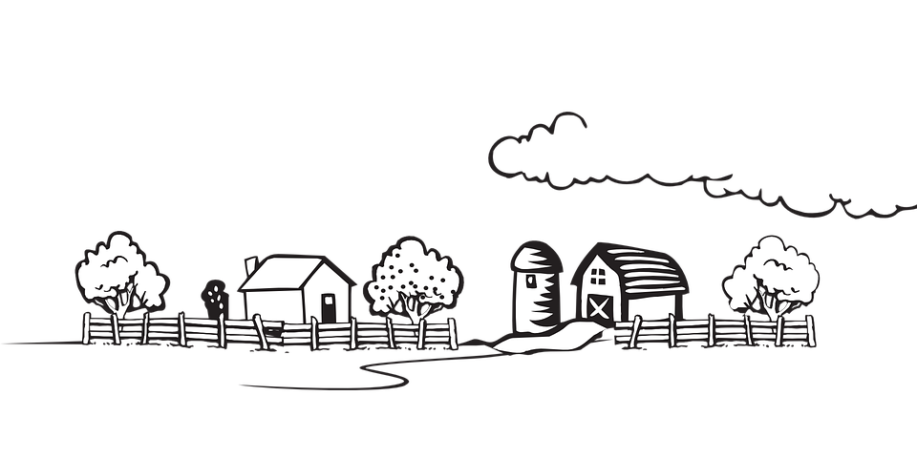

RATE THE fARM
An all in one solution for your farming woes …

Slide 2



Worry no more to start fresh !
Check out our farm rating now !!

Slide 3
Insight into India’s Agricultural Sector
With more than 50% of the population into agriculture, the farmers are the back-bone of our nation.
Despite large areas under agriculture, India's agricultural sector has very low productivity. This is due to several factors such as the limited use of mechanized farming techniques, a lack of adequate equipment and infrastructure, and corruption in the sector.
The farmers are not getting the adequate money as per their investment. This is mainly because of the miscommunication from the middle-men.
There is a need to cater to these problems. Taking all these factors into consideration, the application was built to help the farmers become more aware of their value in market and to help them get inspiration from other farmers, also to help the wholesalers by providing a direct link to the farmers thus avoiding middle-men issues.

Slide 4
Insight into the Application
Upon Launching the application, users are given options to either Sign Up for the first time OR Login using their Email-id and password. There is also an option to reset the password in case the user forgets it.
Depending on whether the user is a farmer or a wholesaler, he will be directed to different pages of his interest.
The farmer is required to enter all the respective details of his farm in the fields provided.
The wholesaler will be directed to the page where the details of different farmers will be displayed along with the ratings. He would also be allowed to rate the farmers based on his experience.
Depending on the information entered in the various fields and the wholesaler ratings respectively, two ratings shall be given, each on a scale of 1 to 5. Their individual ratings will then be used to calculate their cumulative ratings.

Slide 5
The Usefulness of the Application
The application basically serves two purpose.
From the perspective of the farmers, the app provides them a platform to exhibit their property and hard-work, and attract possible customers willing to directly buy products from them. Also, it gives the ratings for them depending on the customer feedback, which encourages them to constantly improve themselves.
From the wholesalers’ perspective, they can directly get in touch with the farmers and get fresh goods directly from the farm. Also, they can negotiate a price which does justice to both the wholesaler and the farmer based on quality.
Therefore, this creates a great platform for the agricultural sector to grow exponentially.

Slide 6
The Source of Our Idea
In the recent years we have seen the farmers quit their lives because of the injustice happening to them by the middle-men who don’t pay the proper price for their crop and loot their hard earned crop. To eliminate this kind of ill-treatment, we came up with this idea. We believe that this will bring transparency in the agricultural sector and improve farmer and wholesaler relationship. Farmers will get their right pay and wholesalers, the right product. Hence, doing justice to both.
Further, there is a need to motivate. The rating creates a kind of healthy competition among the farmers, which encourages them to produce not only more, but better yield.

Slide 7
The Validity of Our Application
The application shall be useful for all the farmers and wholesalers, regardless of their location.
The usage of this application is everlasting.
It is extensible. It can be modified and updated from time to time based on the needs and there is a scope of adding many new features to our application depending upon the requirements.
Easy to use, as all the information will be provided at your fingertips.

Slide 8
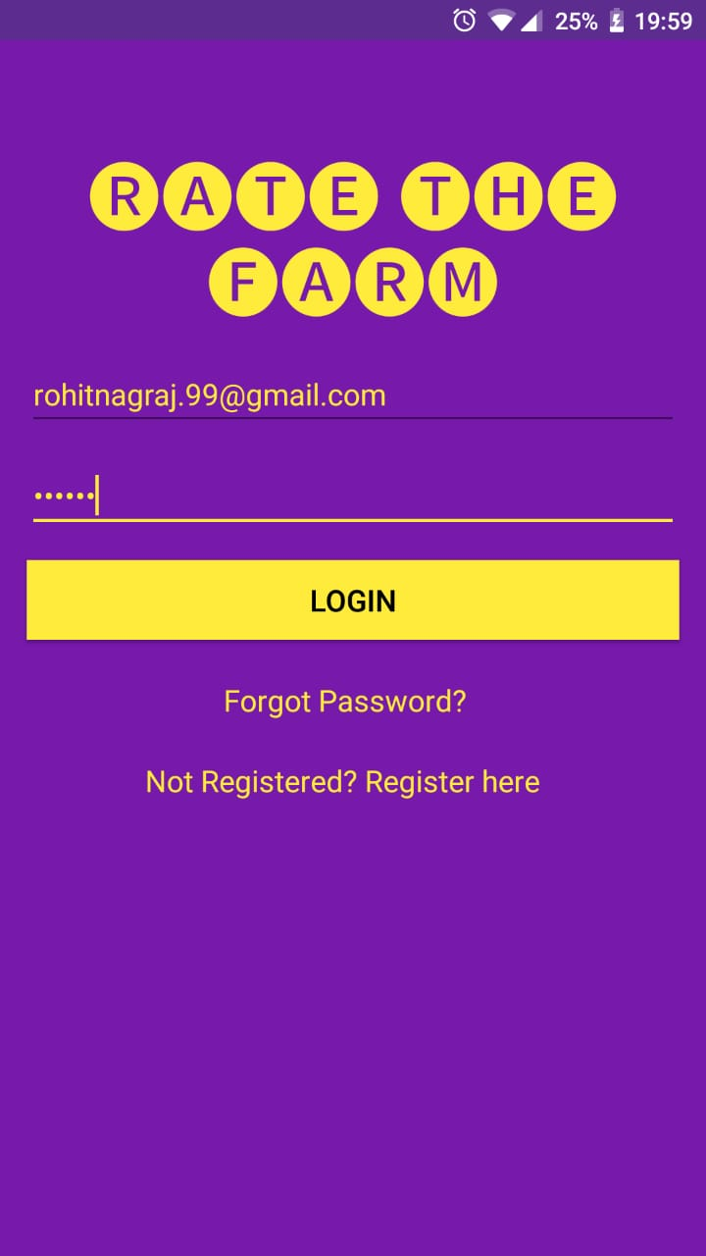
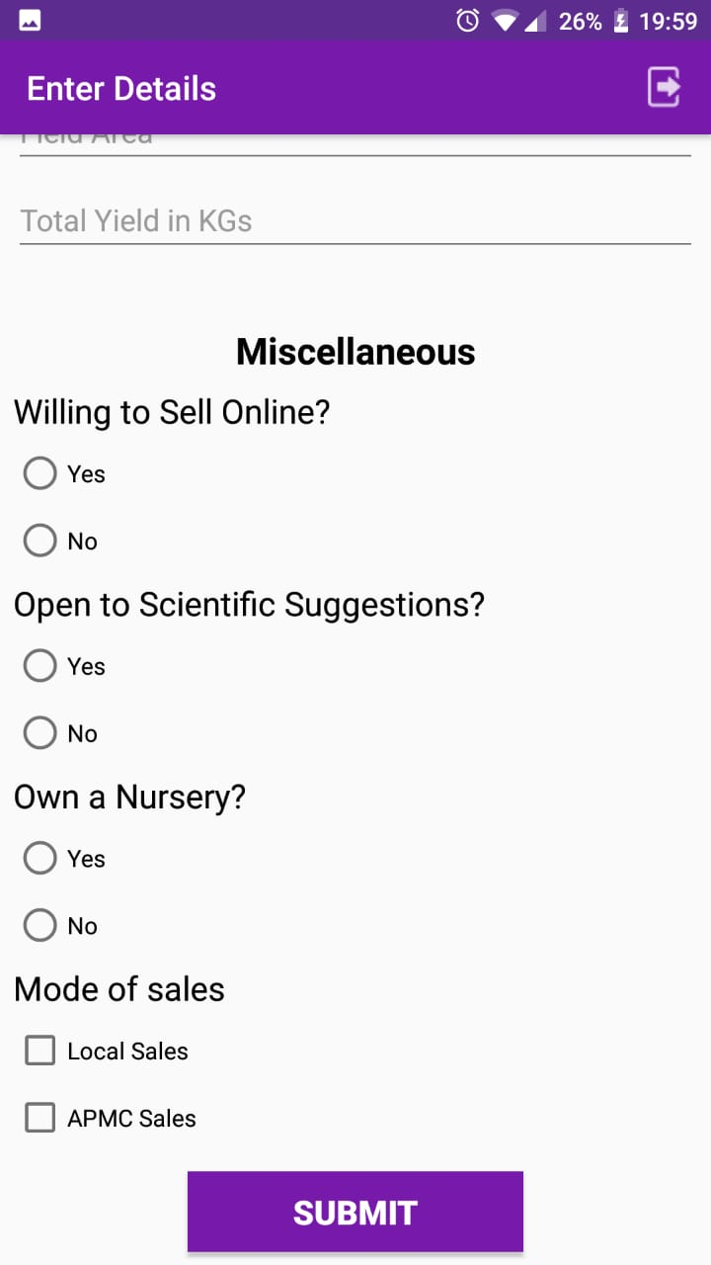
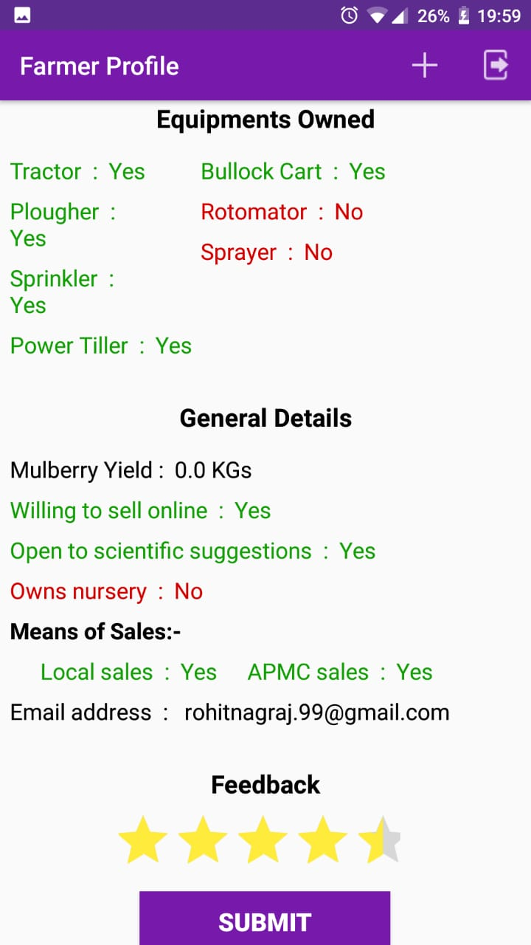
A glimpse of the Application

Slide 9

App Demonstration

